Slide 1

Demand Forecast of Stock Keeping Units
Submitted By:
Krishnakanta Maity
Intern, DPEx, Dr. Reddy’s Lab
Guided By:
Komal Shiva V. Yadav Borra
Lead Data Scientist, Dr. Reddy’s Lab
Supervised By:
Nishit Mittal
Principal Data Scientist, Dr. Reddy’s Lab

Slide 2
Disclaimer
Please note that the views and opinions expressed in this presentation are solely those of the author and do not necessarily reflect the views of Dr. Reddy’s Laboratories. The information presented is based on the author's experience and research during this internship, and may not be comprehensive or applicable to all situations. This presentation is intended for educational and informational purposes only, and should not be used as a substitute for professional advice. The author and Dr. Reddy’s Laboratories make no representations or warranties of any kind, express or implied, about the completeness, accuracy, reliability, suitability, or availability with respect to the information presented. Any reliance you place on such information is therefore strictly at your own risk.

Slide 3
Introduction
The project is focused on SKU (Stock Keeping Unit) demand forecasting, which is a critical aspect for any generic medicine making company. As we all know, accurate demand forecasting is essential for ensuring that we have the right amount of stock at the right time. This is particularly important for our generic medicine manufacturing hub, where we produce a wide range of medicines that are used to treat a variety of illnesses.
Our project aims to develop a robust SKU demand forecasting system that takes into account various factors such as seasonality, market trends, and historical sales data. By doing so, we can ensure that we always have the right amount of stock on hand, minimizing the risk of stock outs or overstocking. By accurately forecasting demand, we can optimize our production schedule, reduce waste, and ensure that we meet the needs of our customers in a timely and efficient manner.

Slide 4
Objective
Our main objective is to develop a demand forecasting system for SKUs using historical sales data and external factors such as market trends and seasonality.
This will help the hub to optimize their inventory management, reduce waste, and improve production planning.

Slide 5
Data Overview-I
Part | Desc | Date | Sales | Market | Country | ….. | Marketing Team
123456 | Medicine 1 | Jan’18 | 23456 | Market 1 | Country 1 | …. | Team 1
123456 | Medicine 1 | Feb’18 | 23000 | Market 1 | Country 1 | …. | Team 1
…. | …. | …. | …. | …. | …. | …. | ….
123456 | Medicine 1 | Mar’23 | 24567 | Market 1 | Country 1 | …. | Team 1
…. | …. | …. | …. | …. | …. | …. | ….
654321 | Medicine 1 | Jan’13 | 23573 | Market 10 | Country 2 | …. | Team 10
654321 | Medicine 1 | Feb’13 | 37893 | Market 10 | Country 2 | …. | Team 10
…. | …. | …. | …. | …. | …. | …. | ….
654321 | Medicine 1 | Mar’23 | 967543 | Market 10 | Country 2 | …. | Team 10
* It’s just a blueprint

Slide 6
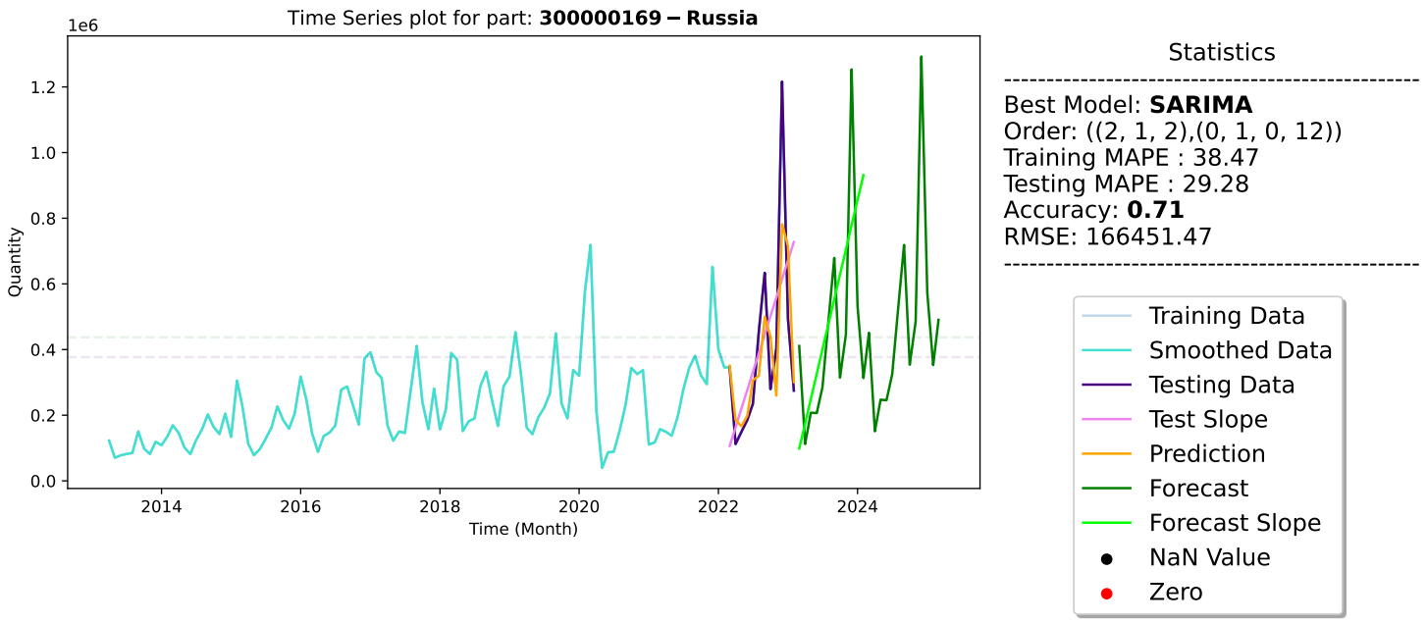
Example

Slide 7
Workflow
Data validation and
Pre-processing
Fitting the appropriate model, testing and forecasting
Sanity check of files and save the final model setting
Based on feedback, take action and implementation
Step-1
Step-2
Step-3
Step-4
Step-5
Step-6
Step-7
Data analysis and bucketing based on data dimension
Checking the results and compare with previous cycle
Send the result to business unit and taking feedback

Slide 8
Data Preprocessing
Step-1
Removing NaN and zero before starting any non-zero sales value
Internal NaN, negative and zero sales imputation.
Mean, Median impute
Average of pre-post value
Forward and backward fill
Treatment for peak and trough
Winsorization
Lowess Smoothing

Slide 9
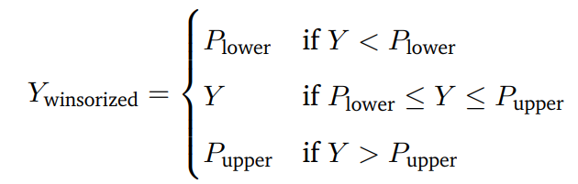
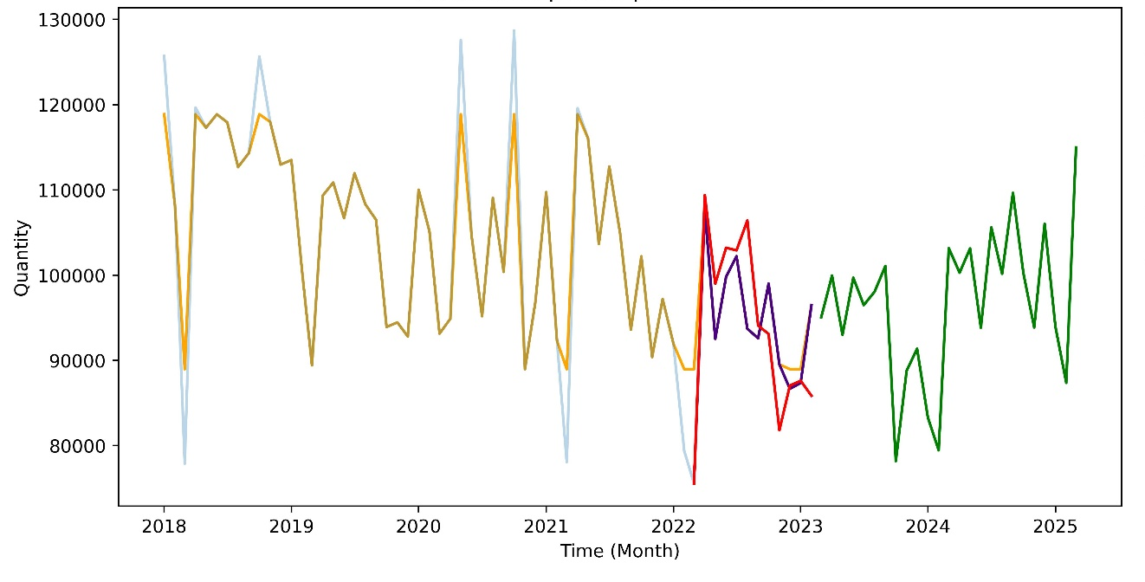
Peak and Trough
Winsorization
5
25
75
95
Winsorization is the technique, which modifies the sample distribution of random variables by removing outliers. For example, 90% winsorization means all data below the 5th percentile is set at 5th percentile and all the data above the 95th percentile is set at 95th percentile.

Slide 10
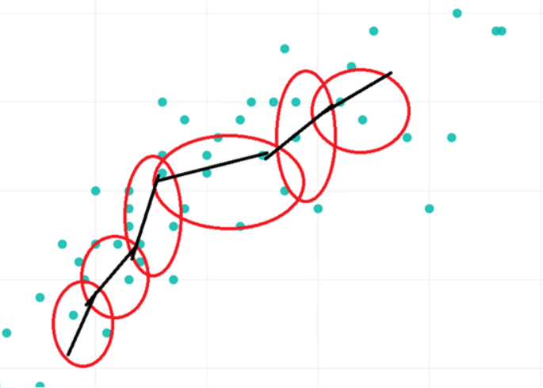

Smoothing
Lowess Smoothing
Locally Weighted Scatterplot Smoothing
Choosing fixed window size k or smoothing parameter f
If f provided, then $k=\left\lceil f×n\right\rceil$, n be the total number of point
For each point select k nearby points
Apply weights using $W\left(d\right)={\left(1−{\left|d\right|}^{3}\right)}^{3}$, d is the distance between point of interest and neighbouring point
Fit a linear regression using weighted data
Repeat the above steps to get smoothed data for all points

Slide 11
Exploratory Data Analysis
Step-2
Market | Cases |  |  |  | Total
Market | Less than 12 months | Greater than 12 months and less than 24 months | Greater than 24 months | Improper
Market-1 | 67 | 13 | 0 | 0 | 80
Market-2 | 669 | 83 | 115 | 2 | 869
Market-3 | 514 | 57 | 69 | 2 | 642
Market-4 | 920 | 115 | 77 | 4 | 1116

Slide 12
Model Pipeline
For Each Part/SKU
Input Format
Models
Good Models
Output
Original Data
Part (SKU) | Part Desc | Date | Quantity
Decompose
ARMA
ARIMA
Good Models for that part
Forecast
Model Training
Metric: RMSE
Best Model
Data Preprocess
SARIMA
Metric: MAPE
PROPHET
TBATS
HW

Slide 13
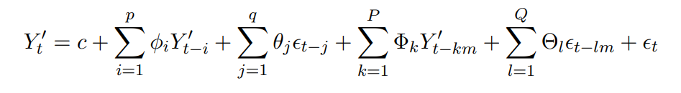

Models-I
ARMA
$${\hat{y}}_{t}=μ+φ_{1}y_{t−1}+…+φ_{p}y_{t−p}−θ_{1}e_{t−1}−…−θ_{q}e_{t−q}$$
ARIMA
${{\hat{y}}^{′}}_{t}=μ+φ_{1}y_{t−1}^{′}+…+φ_{p}y_{t−p}^{′}−θ_{1}e_{t−1}−…−θ_{q}e_{t−q}$, d is chosen by adf test
SARIMA

Slide 14



Models-II
Prophet
TBATS
Holt Winter (Additive)
${\hat{y}}_{t}=L_{t}+T_{t}+S_{t−m+1}$
$$Level: L_{t}=α\left(Y_{t}−S_{t−m}\right)+(1−α)\left(L_{t−1}−T_{t−1}\right)$$
$$Trend: T_{t}=β\left(L_{t}−L_{t−1}\right)+\left(1−β\right)T_{t−1}$$
$$Seasonal: T_{t}=γ\left(Y_{t}−L_{t}\right)+\left(1−γ\right)S_{t−m}$$

Slide 15
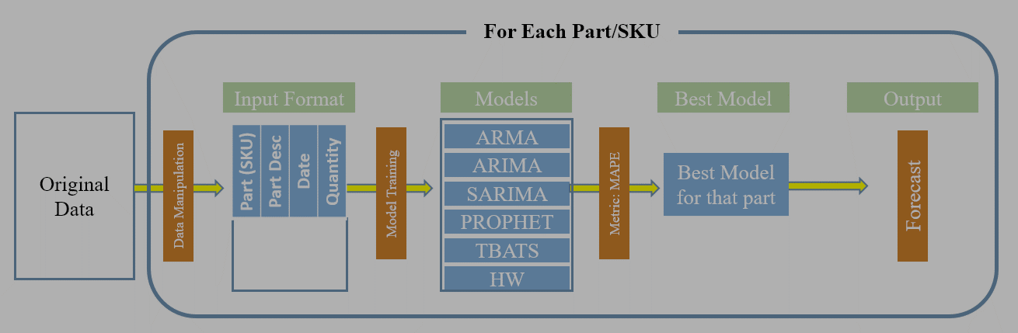
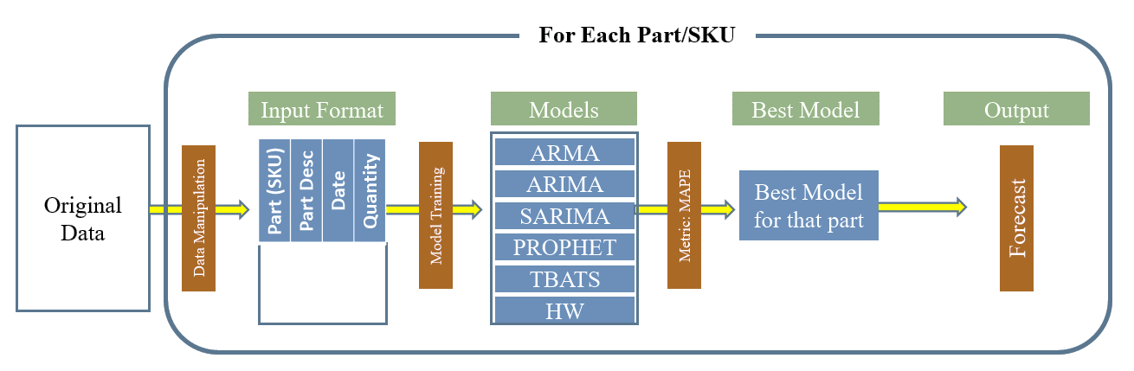
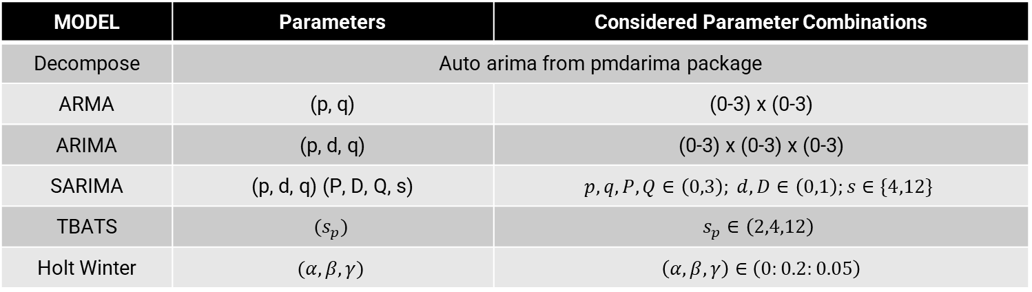
Model Parameter Tuning
Grid Search for each of the model
MODEL | Parameters | Considered Parameter Combinations
Decompose | Auto arima from pmdarima package
ARMA | (p, q) | (0-3) x (0-3)
ARIMA | (p, d, q) | (0-3) x (0-3) x (0-3)
SARIMA | (p, d, q) (P, D, Q, s) | $$p, q, P, Q∈\left(0,3\right); d, D∈\left(0,1\right);s∈\{4,12\}$$
TBATS | $$(s_{p})$$ | $$s_{p}∈\left(2,4,12\right)$$
Holt Winter | $$(α, β, γ)$$ | $\left(α, β, γ\right)∈$ $\left(0:0.2:0.05\right)$

Slide 16

Evaluation Metrics
RMSE (Root Mean Square Error) $RMSE=\sqrt{\frac{1}{T}\sum_{t=1}^{T}{{(A_{t}−F_{t})}^{2}}}$
MAPE (Mean Absolute Percentage Error) $MAPE=\frac{1}{T}\sum_{t=1}^{T}{|\frac{A_{t}−F_{t}}{A_{t}}|}$
MAP (Mean Absolute Percentage Error) $MAP=\frac{1}{T}\sum_{t=1}^{T}{\frac{{|A}_{t}−F_{t}|}{A_{t}}}$
MASE (Mean Absolute Scaled Error) $MASE=\frac{MAP_{Model}}{MAP_{Naive Model}}$
Accuracy $Accuracy=100−MAPE$

Slide 17

Evaluation Metrics
Bias $Bias=\frac{1}{T}\sum_{t=1}^{T}{\frac{A_{t}−F_{t}}{A_{t}}}$
Coefficient of Variation $CV=\frac{SD}{μ}$
Darbin Watson Test p-value $DW=\frac{\sum_{i=1}^{n−1}{{\left(r_{i+1}−r_{i}\right)}^{2}}}{\sum_{i=1}^{n}{r_{i}^{2}}}∼N\left(2,\frac{2\left(1−ρ\right)}{n}\right)$
Null hypothesis: Residuals are uncorrelated i.e. no autocorrelation.
Mean and Comparison between test and forecast phase
AIC, BIC, AICc, BICc

Slide 18
Example

Slide 19
Results – May Cycle
Step-4
Market | Include Neg Acc. | Remove Neg Acc. | Accuracy > 30
Market-1 | 80 | 67 | 64
Market-2 | 752 | 710 | 694
Market-3 | 572 | 564 | 560
Market-4 | 1039 | 932 | 871
Market Wise Accuracy Distribution
Market | MAPE |  |  | Accuracy
 | Min | Max | Average | Min | Max | Average
Market-1 | 0.31 | 94.09 | 17.32 | 5.91 | 99.69 | 82.68
Market-2 | 0.00 | 98.88 | 23.50 | 1.12 | 100 | 76.50
Market-3 | 0.00 | 93.81 | 12.34 | 6.19 | 100 | 87.66
Market-4 | 0.00 | 99.66 | 32.62 | 0.34 | 100 | 67.38
Remove Negative Accuracy
Market | MAPE |  |  | Accuracy
 | Min | Max | Average | Min | Max | Average
Market-1 | 0.31 | 60.16 | 14.13 | 39.84 | 99.69 | 85.87
Market-2 | 0.00 | 69.64 | 22.16 | 30.36 | 100 | 77.84
Market-3 | 0.00 | 65.48 | 11.84 | 34.52 | 100 | 88.16
Market-4 | 0.00 | 69.48 | 29.19 | 30.52 | 100 | 70.81
At-least 30% Accuracy

Slide 20
Future Work
Implement some advanced imputation technique for NaN and zero/negative sales.
Clustering SKUs based on the past behavior and market features.
Use of cluster specific smoothing technique.
Finding best evaluation metrics for each cycle.

Slide 21


Appendix: Script Output
Step-5
For each model (Based on RMSE)
Accumulate the above results (Based on MAPE)
Number of Models
Good Model Prediction
Good Model Forecast
Good Model Summary
Supply Chain Unit
After Accumulate
Best Model Prediction
Best Model Forecast
Best Model Summary

Slide 22
Appendix: Requirements
Packages
warnings, tqdm, logging
numpy, pandas, scipy, matplotlib
stamodels, pdmarima, tsmoothie
System
Acer Laptop, i5-10 Gen, Intel Processer
Google Cloud Platform (GCP) Access, Unlimited Runtime
Use of other team member’s laptops

Slide 23
Thank You

